Slide 1
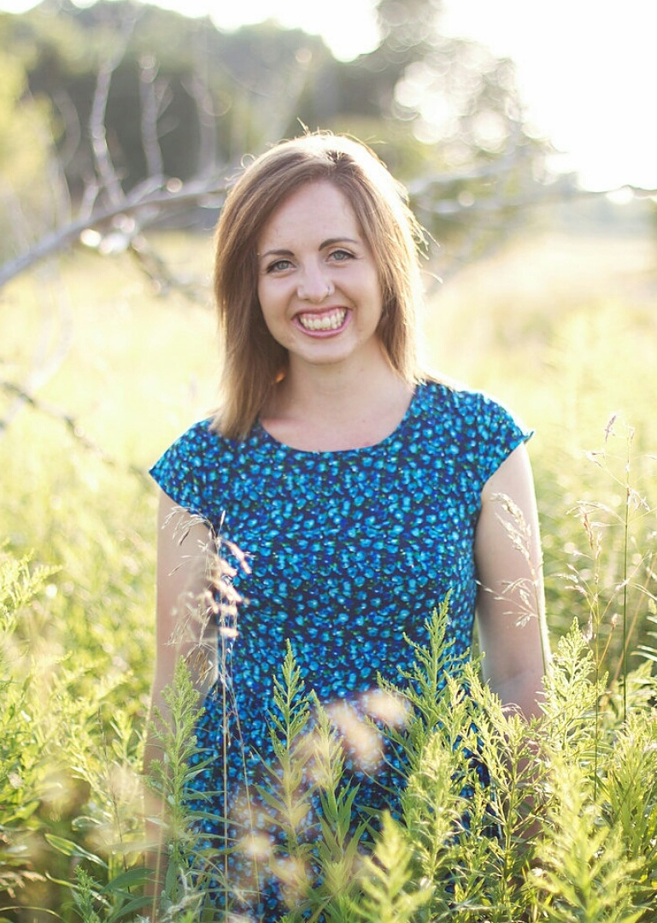
Meet Miss Heimermann
Hello!
I am so excited to be your 4th grade teacher. It’s going to be a great year full of new friends, new adventures, and new discoveries. I am so eager to begin my third year at Clay Lamberton with all of you! I enjoy reading, running, hiking, and spending time with my family and friends. I am grew up in New Holstein, WI with my mom, dad, and younger brother. I graduated from the University of Wisconsin- Oshkosh in 2014, and have called Clay my teaching home and family ever since!
In this classroom..
You are cared about. I value your ideas, thoughts, and actions. You have unique talents and strengths and I can’t wait for you to share them with your classmates. You will bring so much to our class and I can’t wait to learn more about you!
-Miss Heimermann
Contact Me:
I love to have conversations with parents throughout the year. Please always contact me with any questions or concerns. I want to partner with you in order to best support your child! ☺
Bheimermann@berlin.k12.wi.us
Phone: (920) 361- 2442 ext 2211
Website: http://missheimermann.weebly.com

